Slide 1
DHL Approach

Slide 2
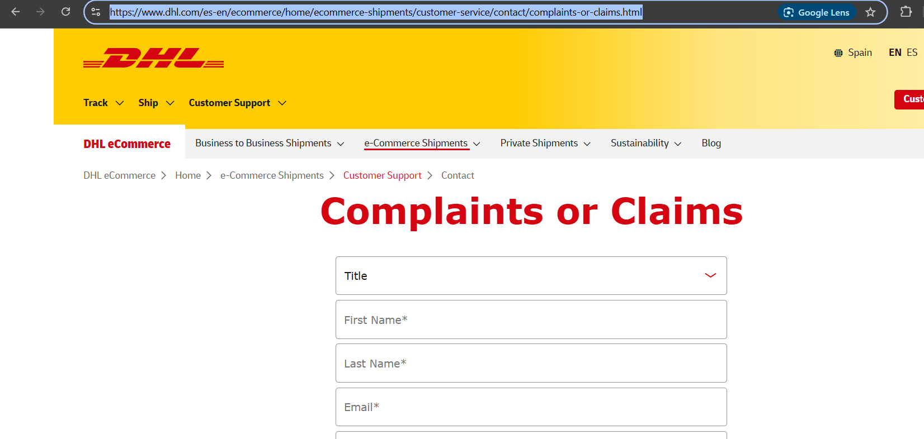
Problem statement
DHL faces challenges in fully understanding customer pain points and areas for improvement due to the lack of customer feedback system. Many customers' concerns and suggestions go uncollected or unaddressed in a timely manner, as the business does not actively seek or properly integrate feedback from all customer touchpoints. This results in an incomplete understanding of customer experiences, limiting DHL’s ability to make informed decisions and quickly respond to issues. As a result, the company risks missing opportunities to enhance service quality, improve customer satisfaction, and stay competitive in the logistics industry.
Notes:
https://www.dhl.com/discover/en-lk/e-commerce-advice/e-commerce-best-practice/customer-satisfaction-in-e-commerce

Slide 3
Use case :Sentiment Analysis and Topic Modelling for Customer Feedback
Data collection
1. DHL’s Official Channels
DHL Website & Customer Surveys: DHL may have customer satisfaction surveys or feedback forms that you can access directly. Often, companies send feedback requests via email or display them on their website. You could monitor these if you're a customer or partner and can participate in or distribute these surveys.
DHL Customer Service: Contact DHL customer service directly and inquire whether they offer data or insights on customer feedback. They may provide aggregated feedback or survey results upon request, especially if you're a business partner.
Twitter, Facebook, Instagram: Customers often post feedback on social media platforms about services they receive. You can use these platforms to monitor mentions of DHL and collect feedback posted by users. You could either manually check or use social media listening tools like Hootsuite or Sprout Social to automate this process.
Reddit: There may be threads or posts on subreddits like r/DHL or r/Shipping where users share their experiences. Reddit also allows you to search by keywords and even filter by time periods to get feedback on specific topics or services.
For this project ,I am using trustpilot reviews as sample data

Slide 4


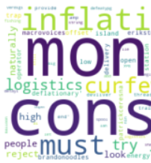

Project approach
Trustpilot reviews
Data Collection
Preprocessing Data
Track sentiment through text analytics
Word Cloud
Data Visualization
Topic Modelling or Which topic is being discussed among customers
Actionable insights to Marketing Team, Customer Service Team, Product Development Team
Notes:
https://www.dhl.com/discover/en-lk/e-commerce-advice/e-commerce-best-practice/customer-satisfaction-in-e-commerce

Slide 5
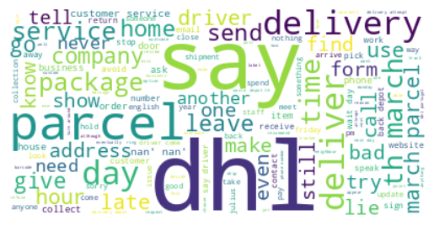
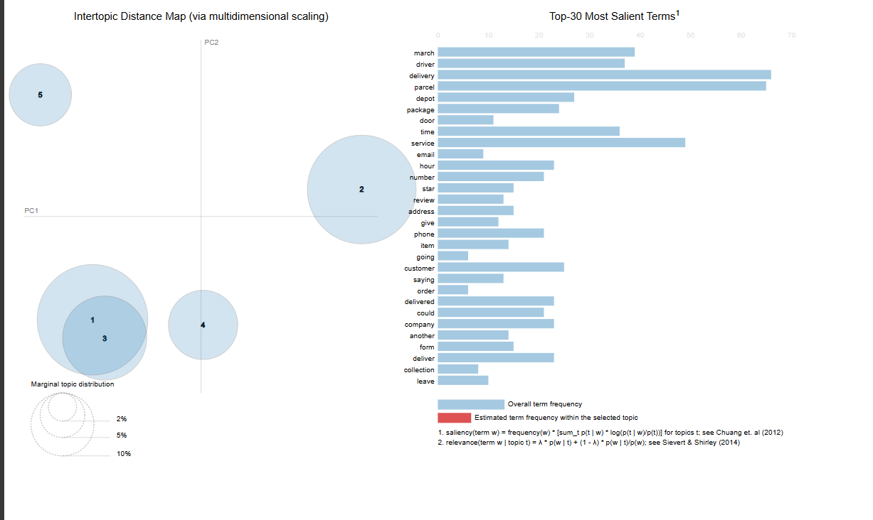
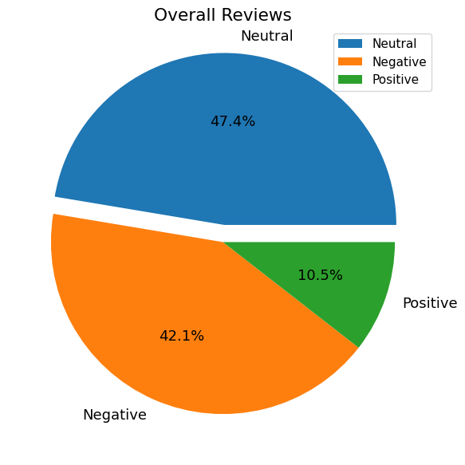
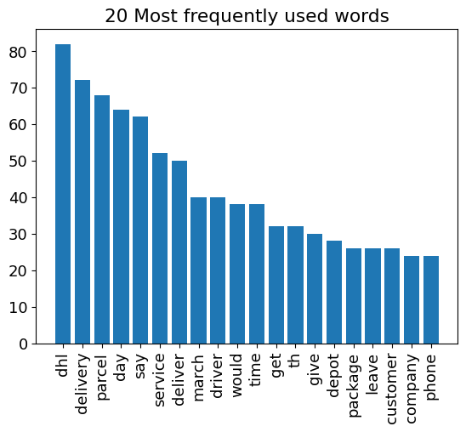
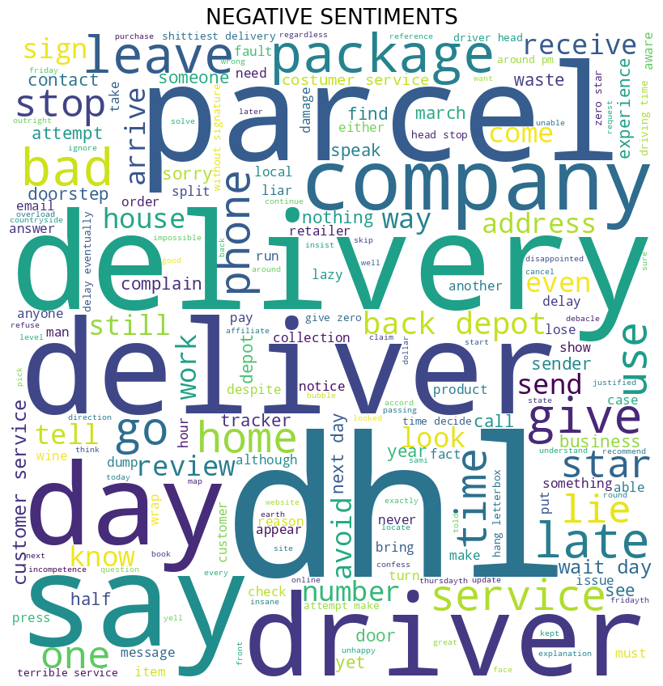
Output samples
Topic modeling
Sentiment analysis
Word cloud and Data Visualization

Slide 6
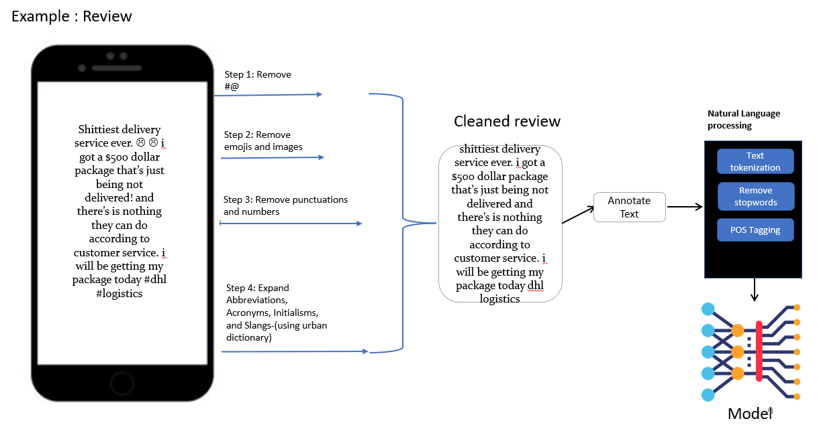
Data collection and Preprocessing

Slide 7
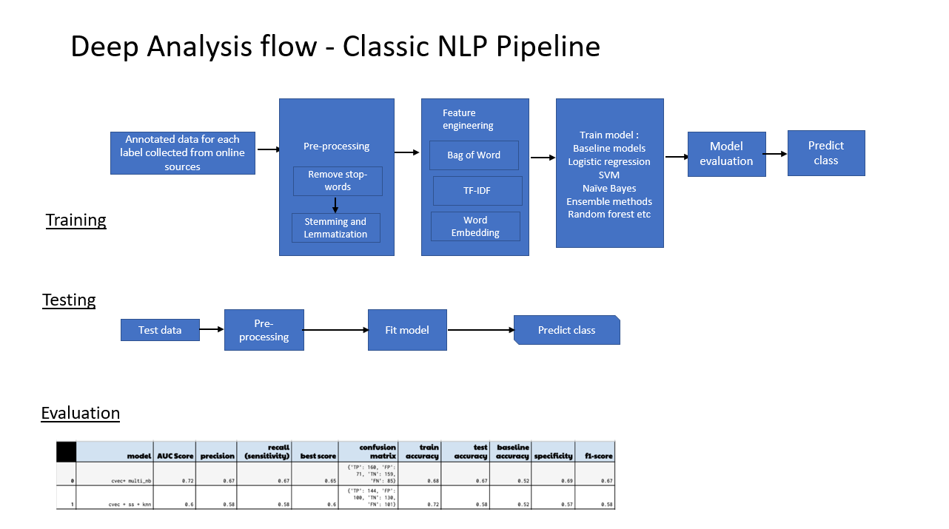

Slide 8
Deploy

Slide 9
Business value added
Enhanced Customer Satisfaction
Actionable Insights: By analyzing sentiment, businesses can directly identify what customers like or dislike about products, services, or experiences. Addressing these sentiments allows businesses to make real-time adjustments that directly improve the customer experience. For example, if customers express frustration over product delivery, businesses can resolve these issues swiftly, leading to greater satisfaction.
Faster Response to Issues: Topic modeling identifies recurring issues, allowing businesses to quickly prioritize common complaints (e.g., shipping delays or product defects) and implement solutions, improving overall customer experience.
Improved Customer Retention
Personalized Engagement: Sentiment analysis helps businesses understand the emotional state of customers and tailor responses accordingly. Happy customers can be engaged with loyalty offers, while unhappy ones can receive personalized support to resolve issues, enhancing the likelihood of retention.
Proactive Problem Solving: When businesses recognize negative sentiments early, they can take action before issues escalate, ensuring customers feel heard and valued. This proactive approach builds trust and encourages long-term loyalty.
Informed Product Development
Identifying Pain Points: Topic modeling allows businesses to uncover common themes in customer feedback, such as frequently mentioned product flaws or desired features. This data can be directly applied to guide the product development team in making meaningful improvements.
Customer-Driven Innovation: By continuously analyzing customer feedback, businesses can align new product ideas with actual customer needs and demands. This helps in designing products that are more likely to succeed in the market, based on real-world feedback.
Better Customer Service
Improving Service Quality: Sentiment analysis uncovers customer satisfaction levels with customer service interactions, highlighting areas that need improvement. If the feedback shows frustration with long wait times or unhelpful responses, businesses can focus on improving these service aspects.
Real-Time Feedback: By continuously monitoring customer feedback, businesses can respond quickly to emerging service issues, ensuring fast resolutions. This builds customer trust, showing that the business is committed to delivering excellent service.

Slide 10
Future oppurtunities
1. Ongoing Monitoring
Continuous Feedback Analysis: By continuously applying sentiment analysis and topic modeling to incoming customer feedback, businesses gain real-time insights into customer sentiment. This allows teams to detect emerging issues or trends as they happen, ensuring that businesses can stay agile and responsive.
Proactive Issue Resolution: Ongoing monitoring helps businesses identify and address negative sentiment or recurring problems early, often before they escalate into larger issues that affect many customers. This proactive approach improves customer experience and helps prevent potential churn.
Real-Time Adjustments: If feedback shows sudden spikes in negative sentiment related to a specific product feature, service, or issue, businesses can make quick adjustments or improvements in real-time, avoiding customer dissatisfaction and mitigating risk.
2. Reporting
Actionable Insights: Summary reports generated from sentiment analysis and topic modeling provide businesses with clear, actionable insights. These insights can highlight customer satisfaction trends, product pain points, and frequently discussed topics. By having these insights in a digestible format, stakeholders (e.g., product development, marketing, customer service teams) can quickly take informed actions.
Strategic Decision-Making: Reports help teams make data-driven decisions about resource allocation, product improvements, and customer engagement strategies. For example, if reports reveal a negative sentiment trend related to product delivery, the logistics or customer service teams can prioritize resolving these concerns.
Data Visualization: Reports are often accompanied by visualizations such as graphs, charts, and heat maps. This makes it easier for decision-makers to quickly interpret complex feedback data and track key metrics, such as sentiment over time or common topics discussed in feedback.

Slide 11
Context-Aware Sentiment Analysis
Understanding Customer Intent: Sentiment analysis models that are context-aware consider the nuances of language, such as sarcasm, tone, and cultural references, which are common in customer feedback. This means the analysis goes beyond just categorizing feedback as “positive” or “negative,” instead providing a deeper understanding of the customer’s true sentiment.
Accurate Feedback Interpretation: A context-aware approach ensures that businesses can make more accurate decisions based on real feedback. For example, understanding whether a seemingly negative review is driven by a specific, isolated issue or a broader customer frustration allows businesses to address problems more effectively.
Tailored Responses: With context-aware sentiment analysis, businesses can personalize their interactions with customers. If a customer is dissatisfied with a particular feature, a tailored, empathetic response addressing the exact concern is more likely to improve their overall experience and retain their loyalty.
4. Insight Generation and Visualization
Automatic Topic Extraction: Topic modeling uncovers the key themes emerging in customer feedback, such as common complaints, suggestions, or product praises. This allows businesses to track which aspects of their products or services are being most discussed, helping to prioritize areas for improvement.
Clear Visual Dashboards: Visual dashboards present sentiment and topic modeling results in an intuitive format. These visualizations allow teams to see trends in sentiment over time, identify high-priority issues, and spot emerging topics (e.g., delivery concerns or specific product features) in real time.
Strategic Insights: Combining sentiment analysis and topic modeling with data visualizations empowers stakeholders to make informed decisions quickly. For example, if a visualization highlights a growing concern about product quality, teams can investigate further and take immediate action to address quality control or communication strategies.

Slide 12
Beyond the purchase: building long-term relationships
Building long-term customer relationships extends beyond transactions. Loyalty programmes that reward repeat purchases, offer special discounts, or provide early access to new products can foster a sense of belonging and appreciation. Implementing best practices in customer satisfaction surveys, such as timely surveys after purchase or interaction and keeping them concise yet comprehensive, can provide deeper insights into customer needs and satisfaction levels.
Engaging content, such as blogs, tutorials, or user-generated content, adds value beyond the product. Active social media engagement allows for a more personal and interactive relationship with customers, providing platforms for feedback, queries, and community building. Examples of customer satisfaction in this case include positive feedback on social media, high engagement rates with content, and customers sharing their experiences with the brand online. These interactions not only enhance customer relationships but also serve as powerful endorsements, further attracting new customers and retaining existing ones.

Slide 13
In e-commerce, logistics plays a pivotal role in defining customer satisfaction. DHL Express, with its reliable track and trace capabilities and efficient last-mile delivery services, ensures that customers are always in the loop with their orders. A key tool in this process is the DHL app, which offers the flexibility to track shipments in real-time and make changes as needed, enhancing their control and convenience.
Moreover, our streamlined return process enhances the overall e-commerce customer experience, reinforcing trust and satisfaction. The quality of our logistical services, from the accuracy of tracking to the promptness and care in delivery, significantly impacts customer perceptions and satisfaction levels. DHL Express's commitment to providing high-quality, reliable logistics solutions plays a crucial role in maintaining and elevating customer satisfaction standards in the e-commerce industry.
Mastering customer satisfaction in e-commerce is a multifaceted endeavour that requires attention to detail, a deep understanding of customer expectations, and a commitment to continuous improvement. Understanding ways to improve in these key areas is crucial; businesses must actively seek customer feedback, analyse purchasing patterns, and stay up-to-date on market trends. Implementing user feedback into the improvement process, continuously optimising the website experience, and personalising customer interactions are vital steps. By focusing on these key areas and adapting to evolving customer needs, businesses can not only meet but exceed customer expectations, leading to sustained growth and success.

